Slide 1
System Reliability

Slide 2
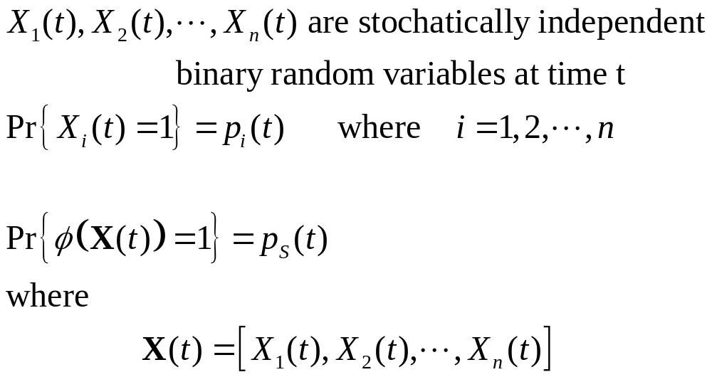
Random State Variables

Slide 3
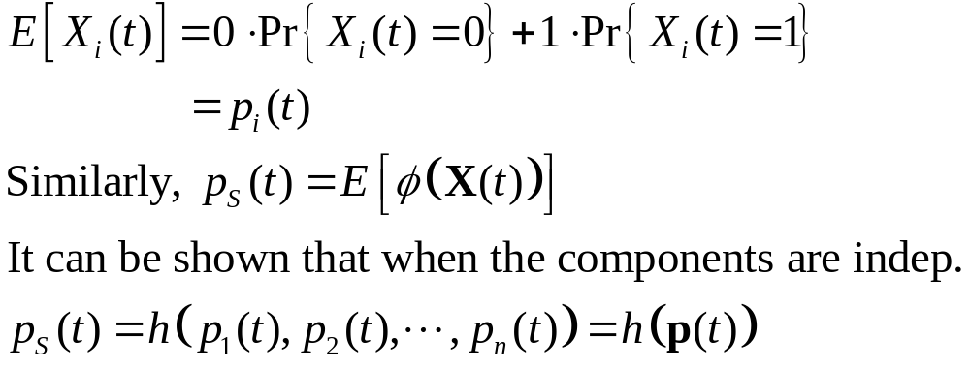
System Reliability/Availability

Slide 4
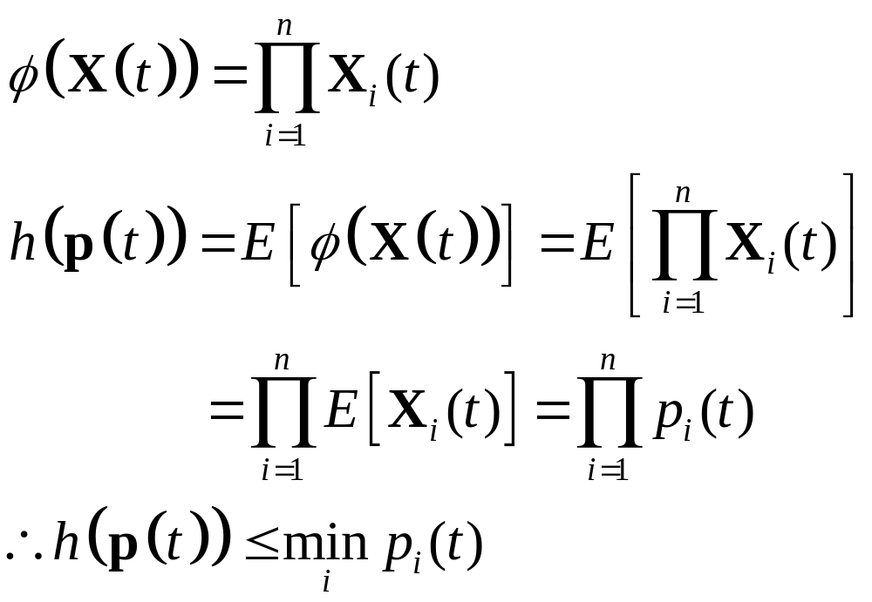
Series Structure

Slide 5
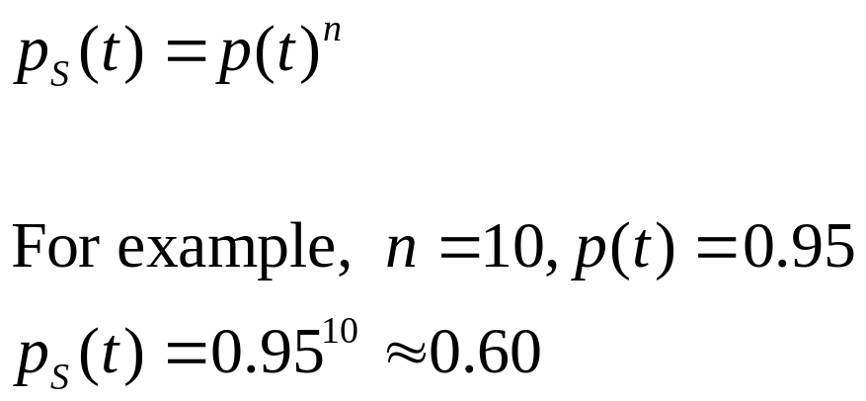
Series Structure
A series structure is at most as reliable as the least reliable component. For a series structure of order n with the same components, its reliability is

Slide 6
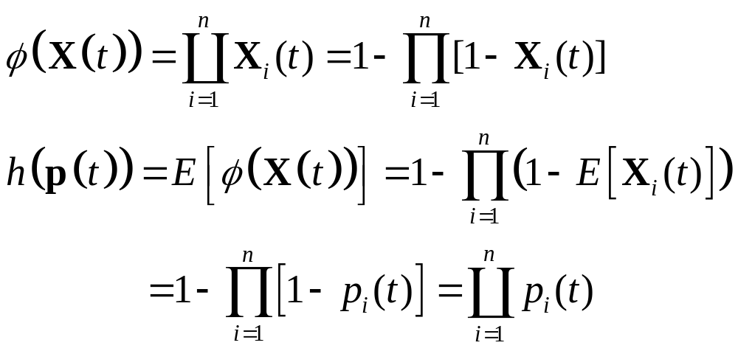
Parallel Structure

Slide 7
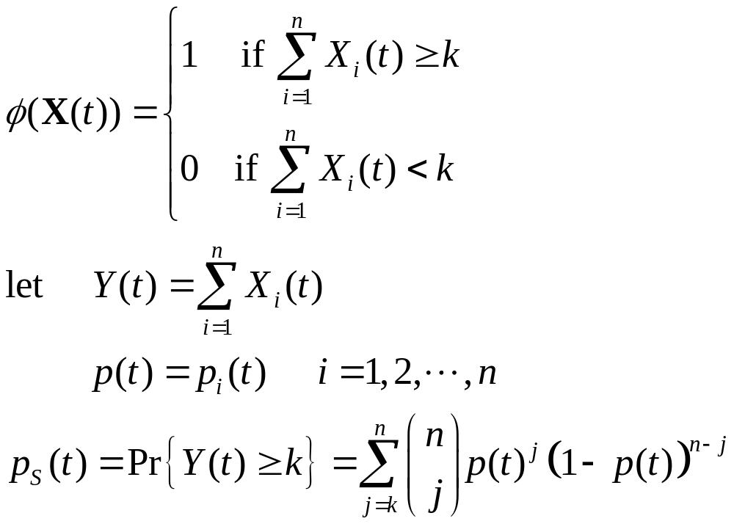
k-out-of-n Structure

Slide 8
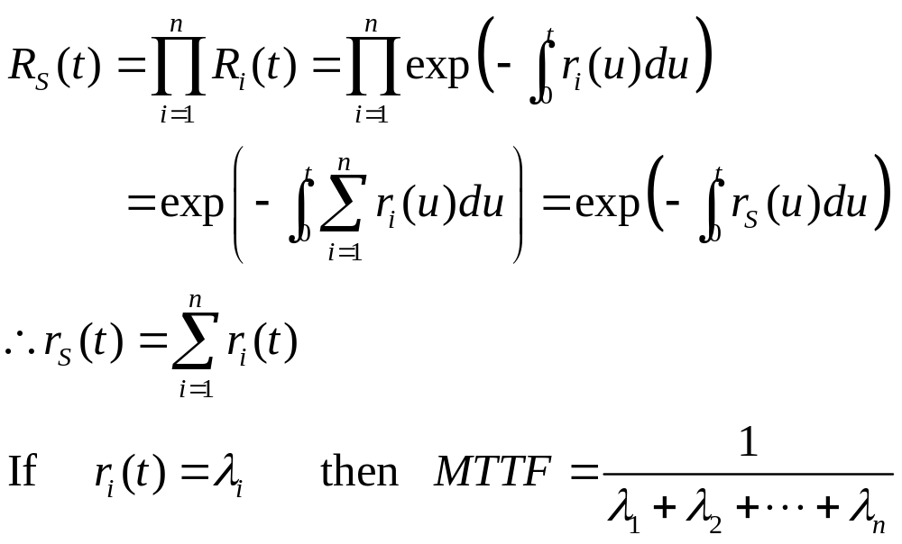
Non-repairable Series Structures

Slide 9
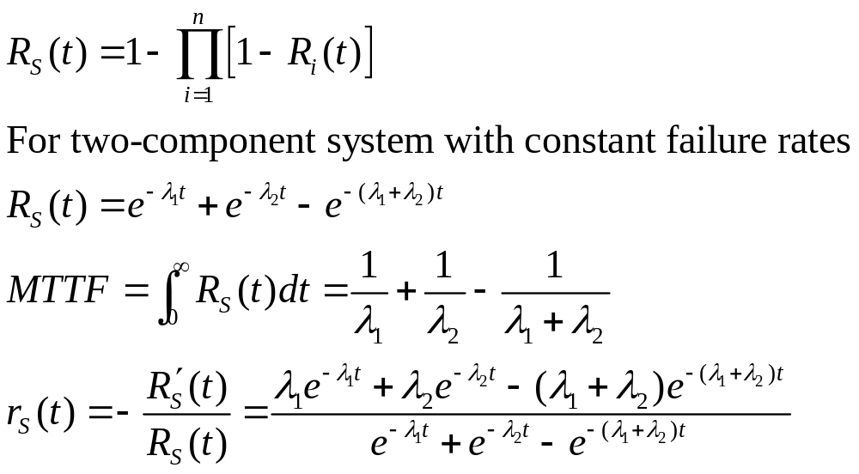
Non-repairable Parallel Structures

Slide 10
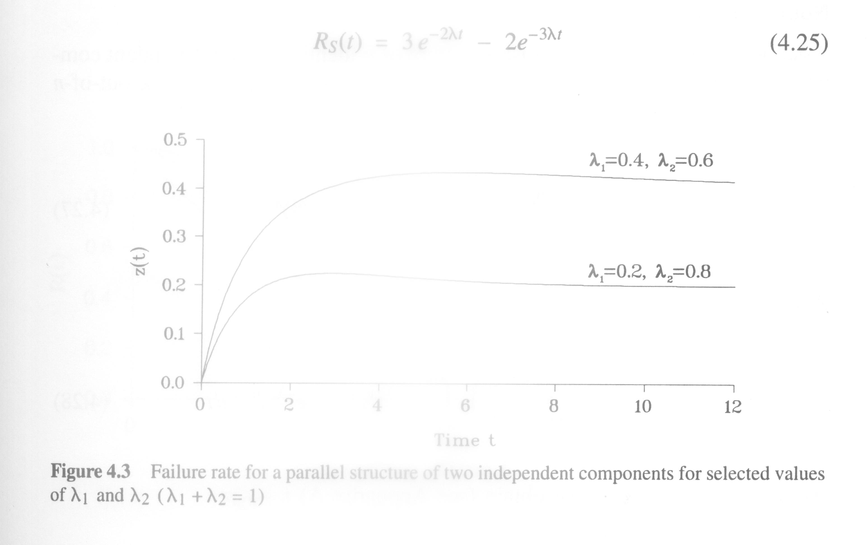
r(t)
This example illustrates that even if the individual components of a system
have constant failure rates, the system itself may have a time-variant failure
rate.

Slide 11
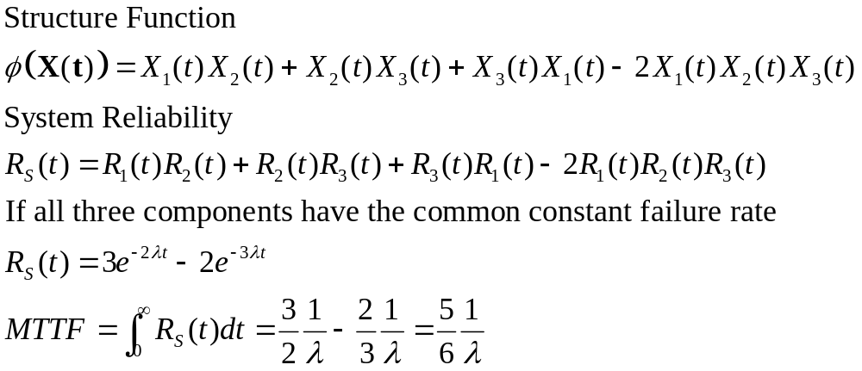
Non-repairable 2oo3 Structures

Slide 12
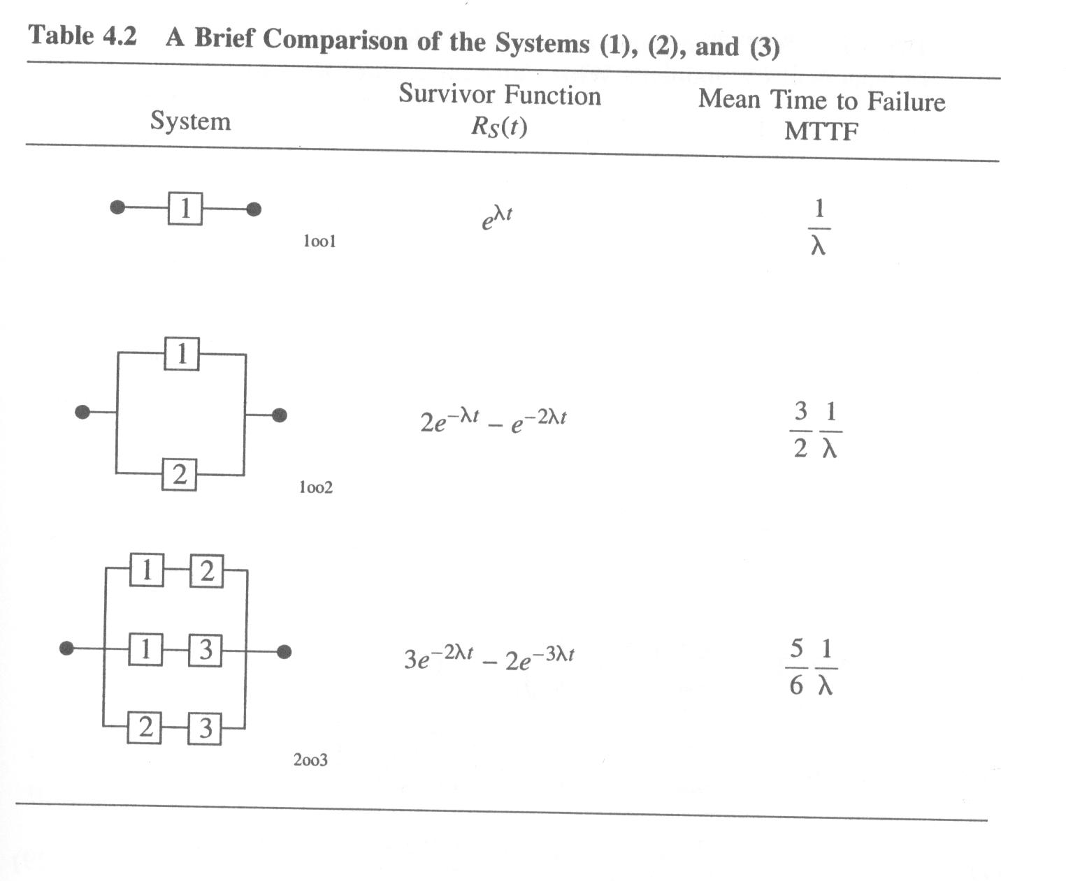

Slide 13
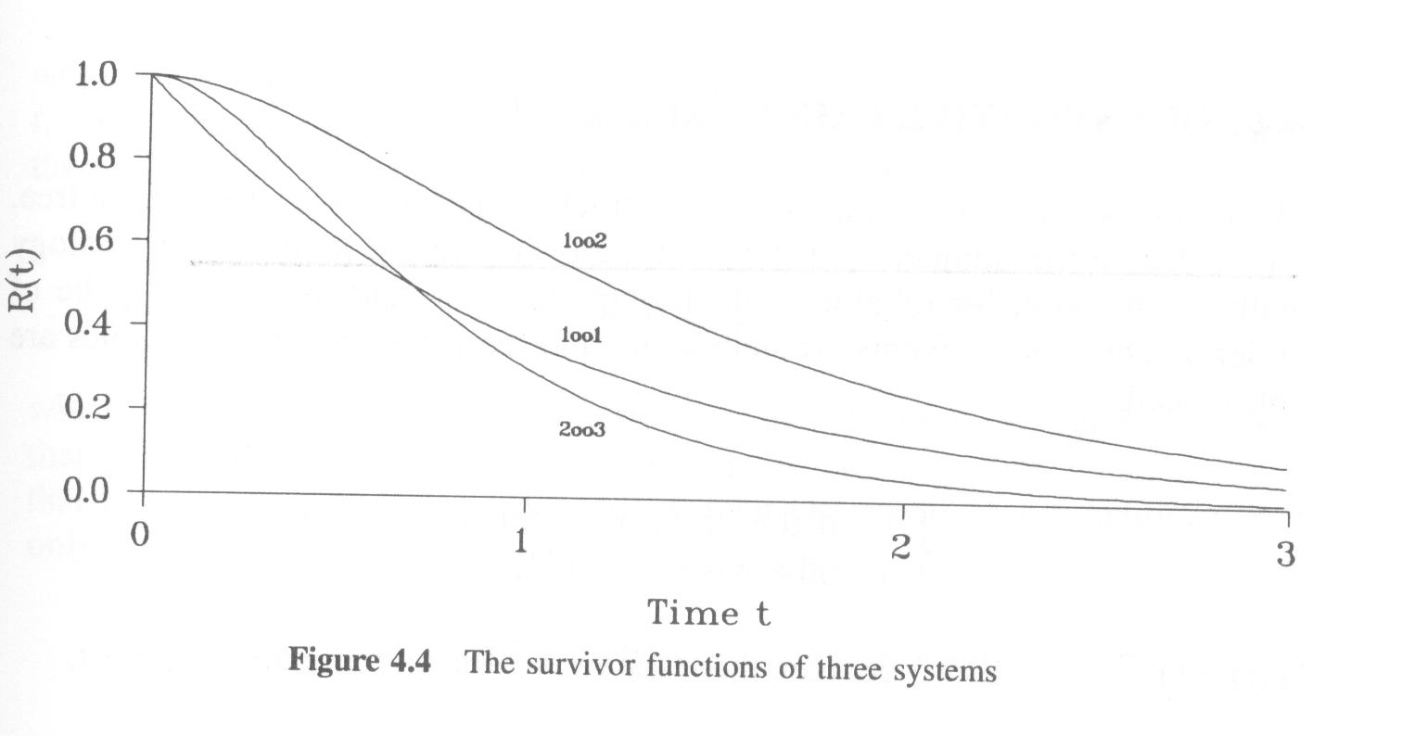


Slide 14
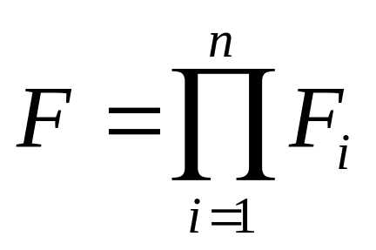
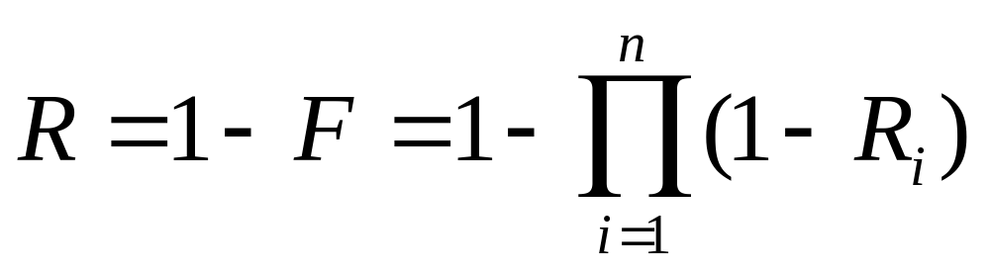
A System with n Components in Parallel
Unreliability
Reliability

Slide 15
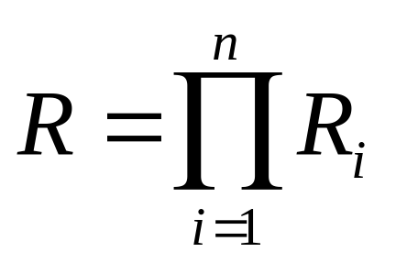
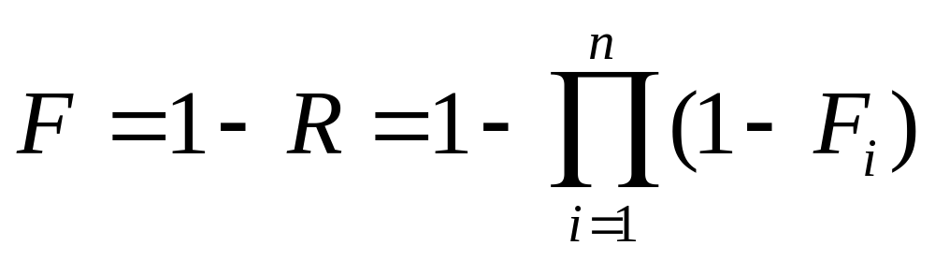
A System with n Components in Series
Reliability
Unreliability

Slide 16
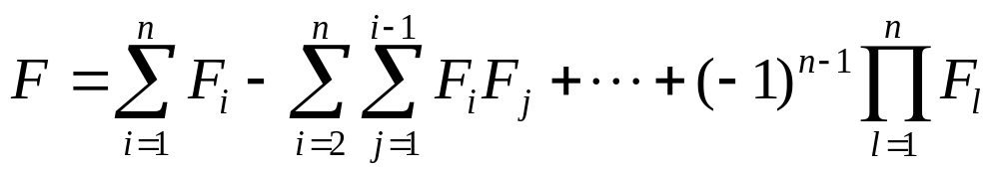
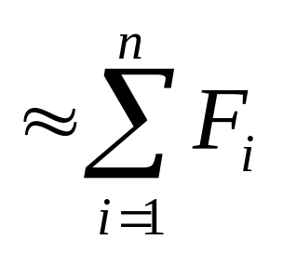
Upper Bound of Unreliability for Systems with n Components in Series

Slide 17
Pressure
Switch
Alarm
at
P > P_{A}
PIA
PIC
Pressure
Feed
Solenoid
Valve
Reactor
Figure 11-5 A chemical reactor with an alarm and inlet feed solenoid. The alarm and feed shutdown systems are linked in parallel.

Slide 18
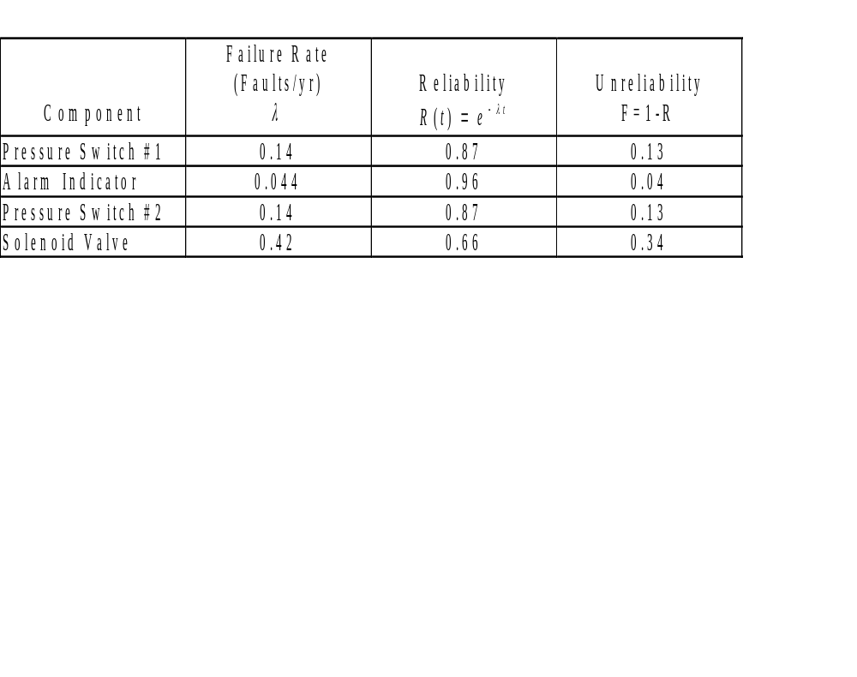

Slide 19
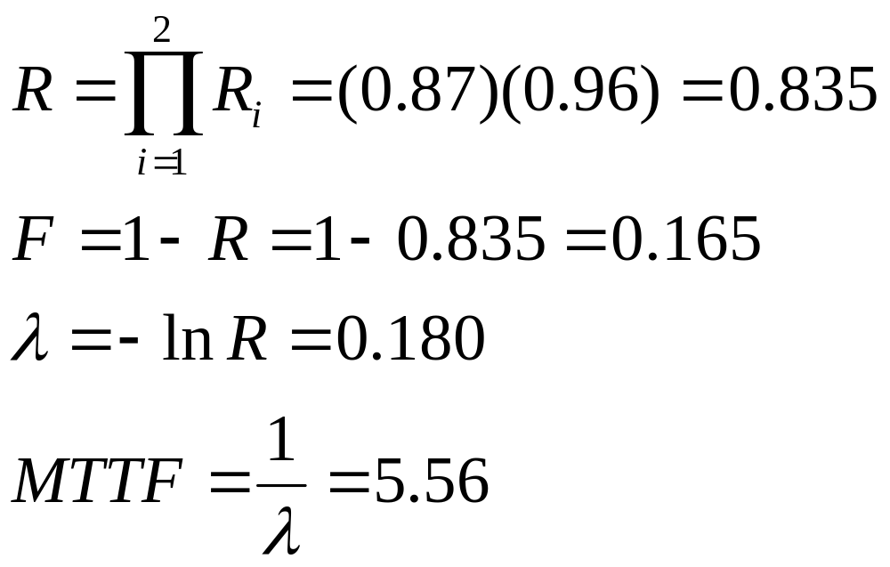
Alarm System
The components are in series
Faults/year
years

Slide 20
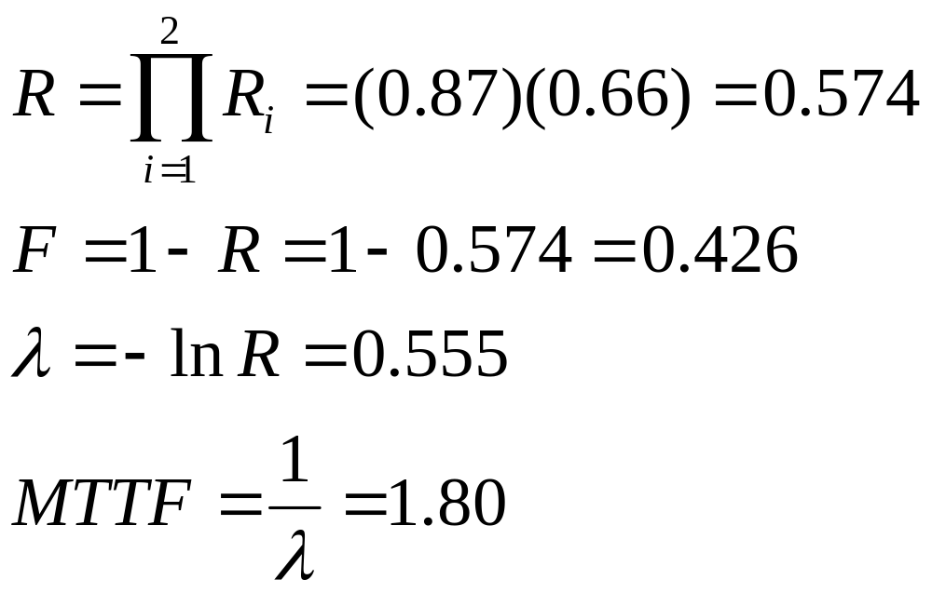
Shutdown System
The components are also in series:

Slide 21
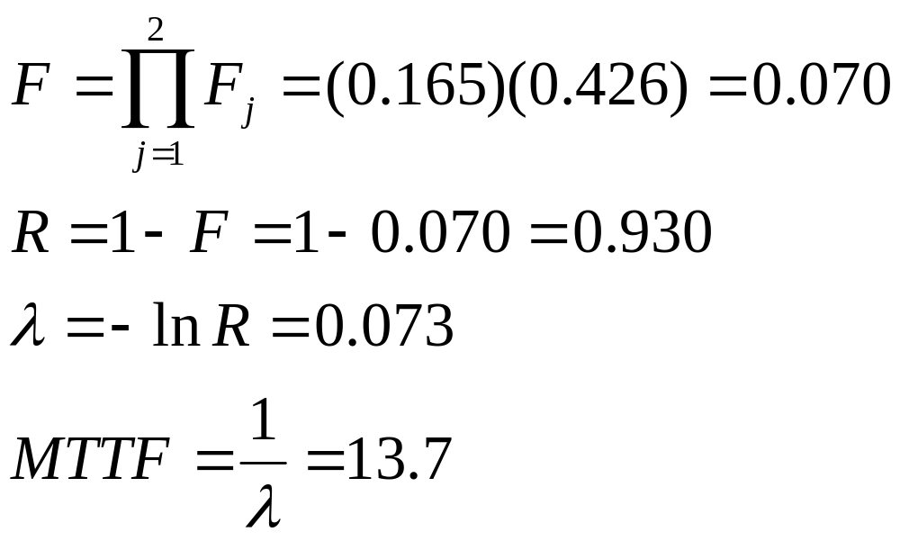
The Overall Reactor System
The alarm and shutdown systems are in parallel:

Slide 22
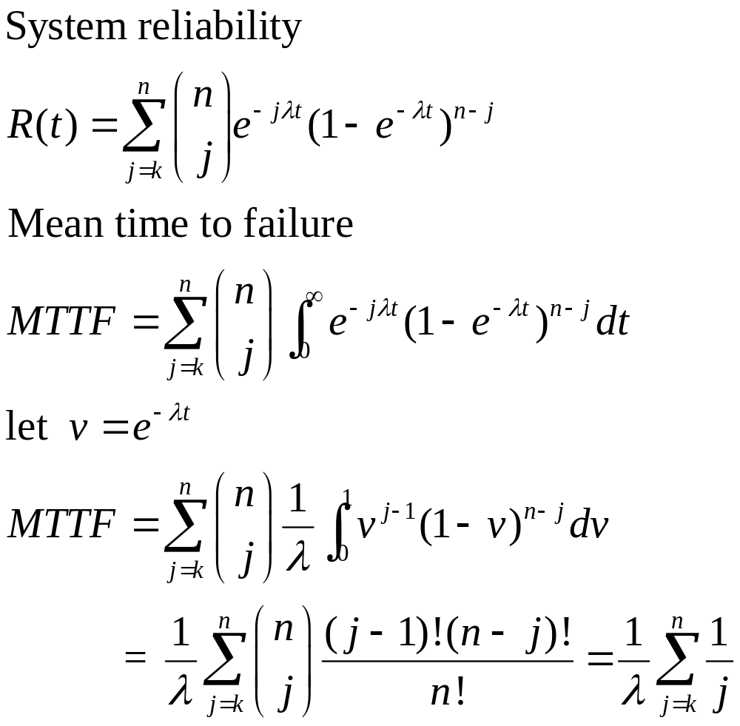
Non-repairable k-out-of-n Structures

Slide 23
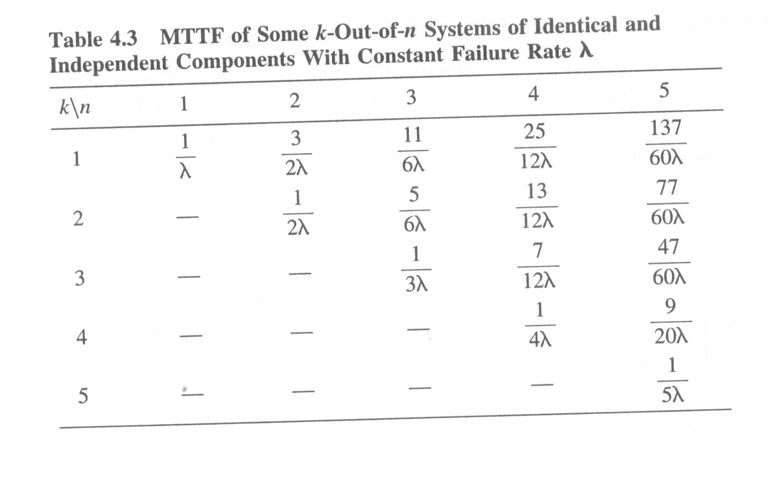

Slide 24
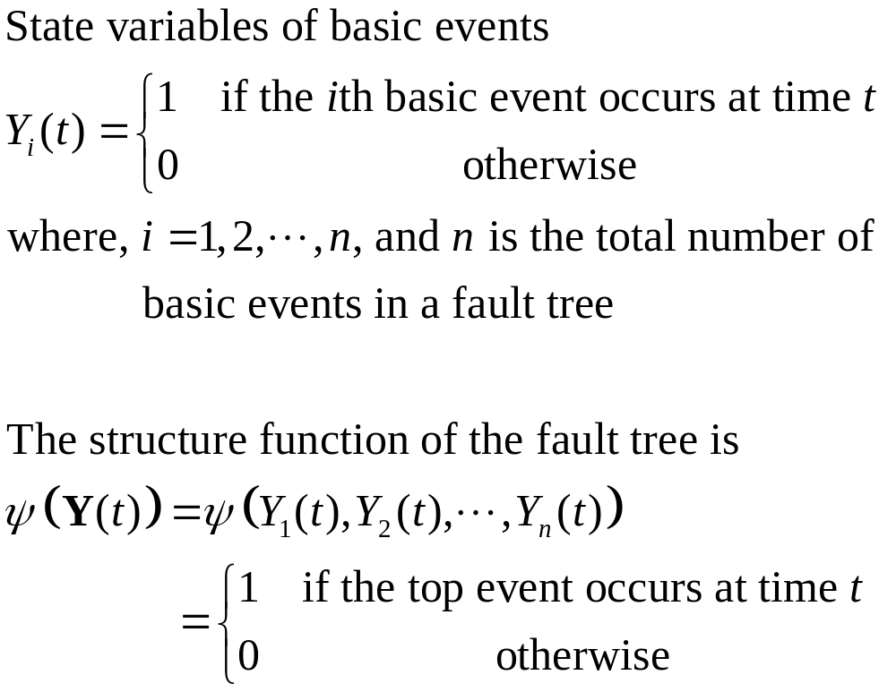
Structure Function of a Fault Tree

Slide 25
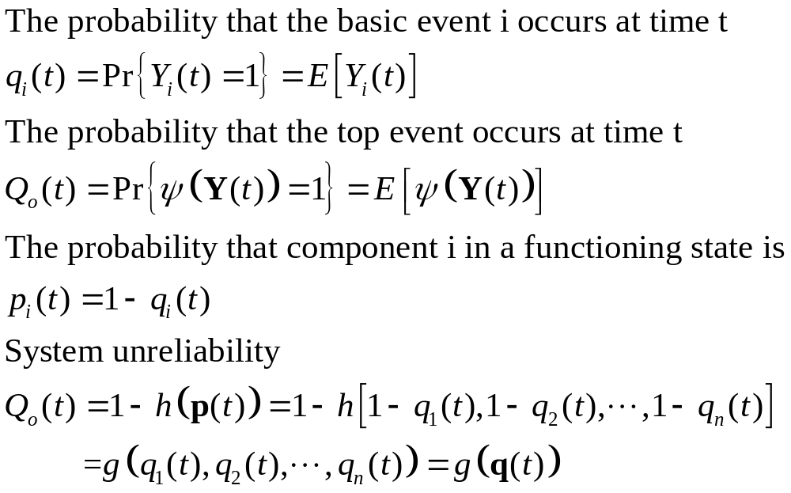
System Unreliability

Slide 26
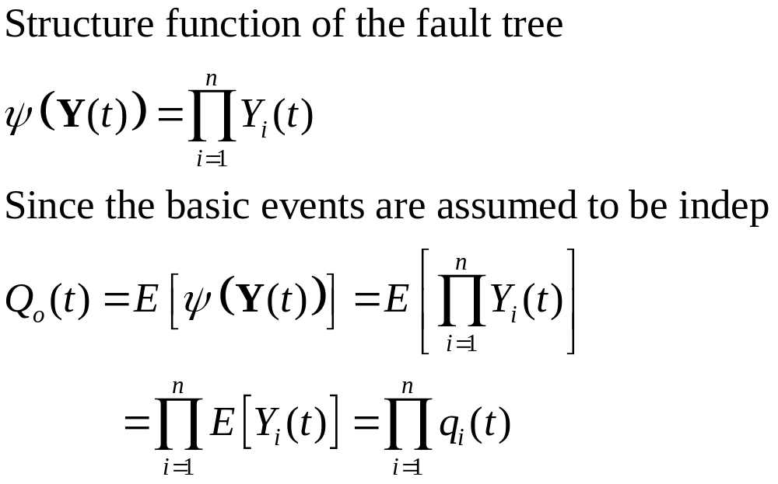
Fault Trees with a Single AND-gate

Slide 27
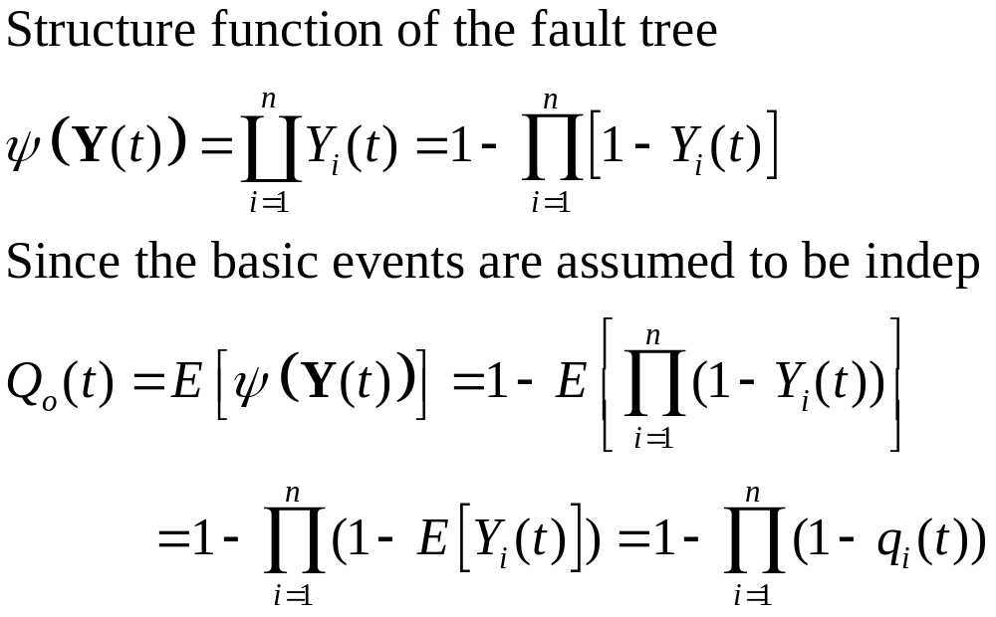
Fault Trees with a Single OR-gate

Slide 28
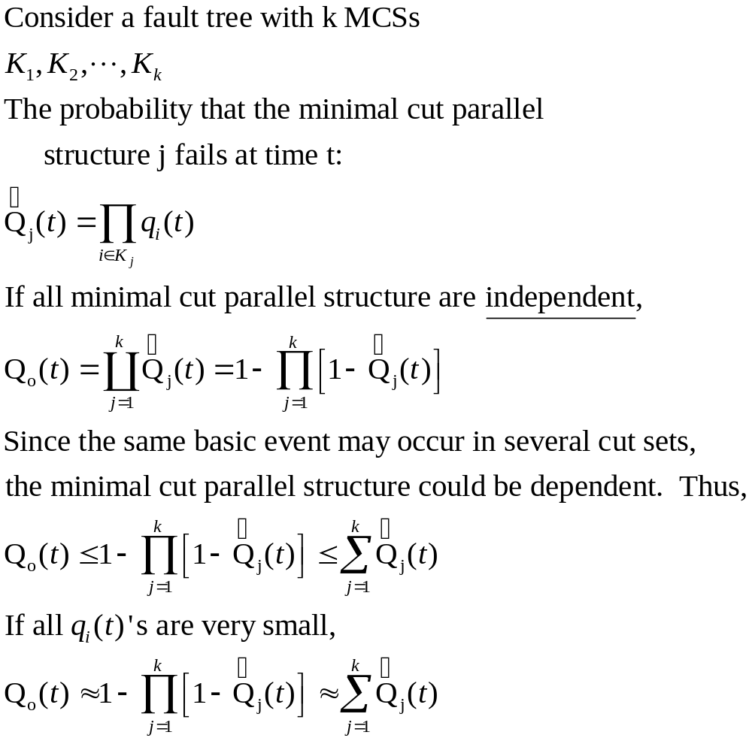
Approximate Formula for System Unreliability

Slide 29
Exact System Reliability
Structure Function
Pivotal Decomposition
Minimal Cut (Path) Sets
Inclusion-Exclusion Principle

Slide 30
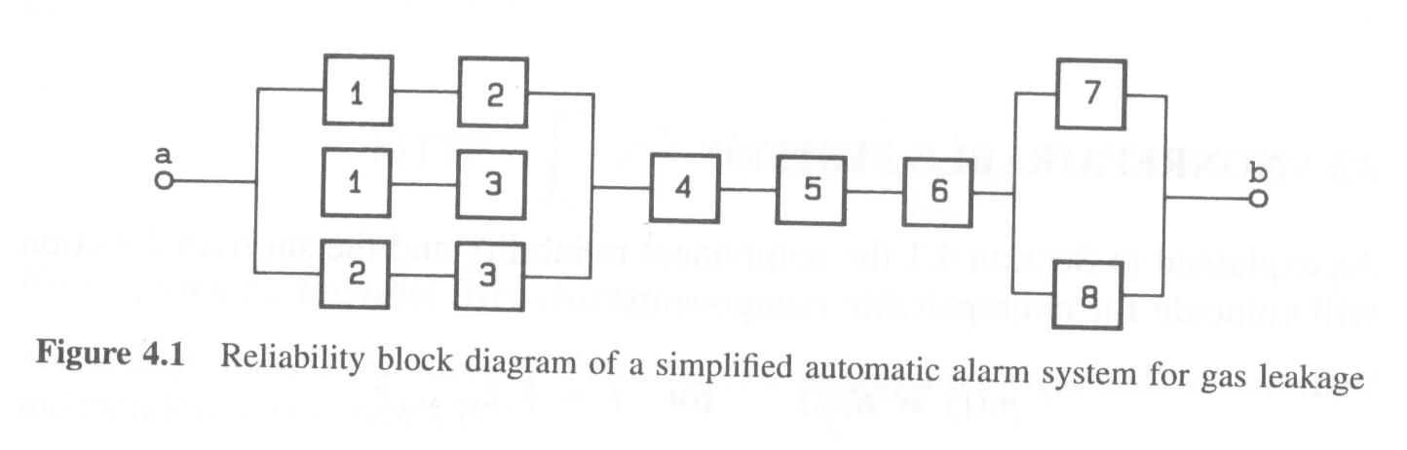
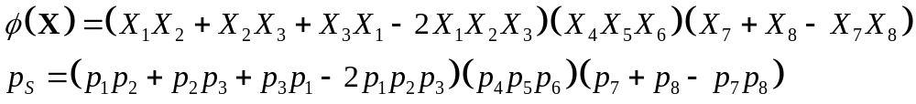
Reliability Computation Based on Structure Function

Slide 31
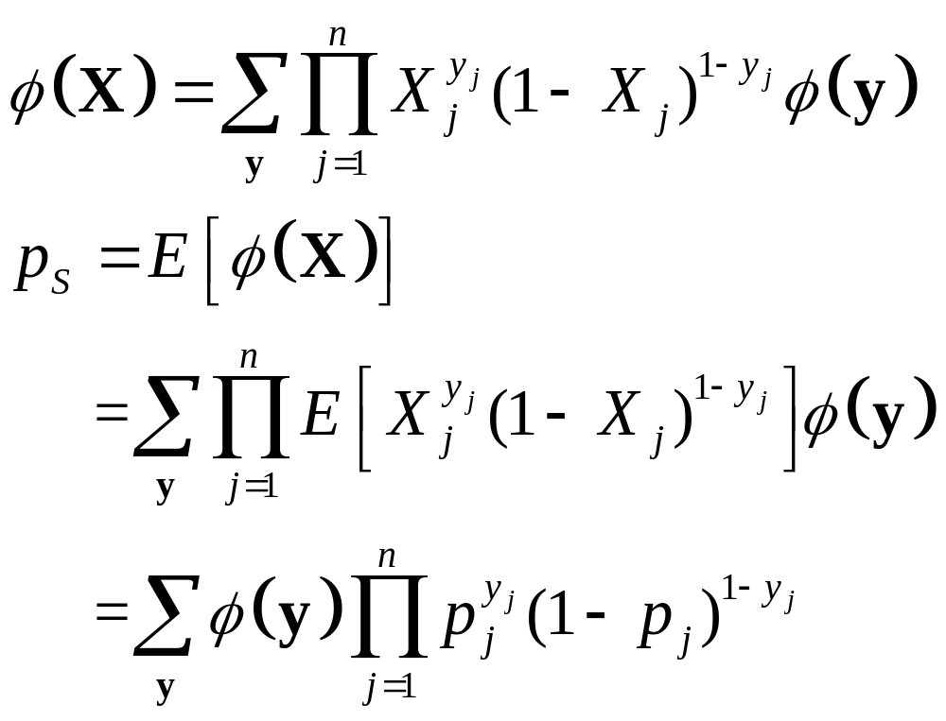
Reliability Computation Based on Pivotal Decomposition

Slide 32
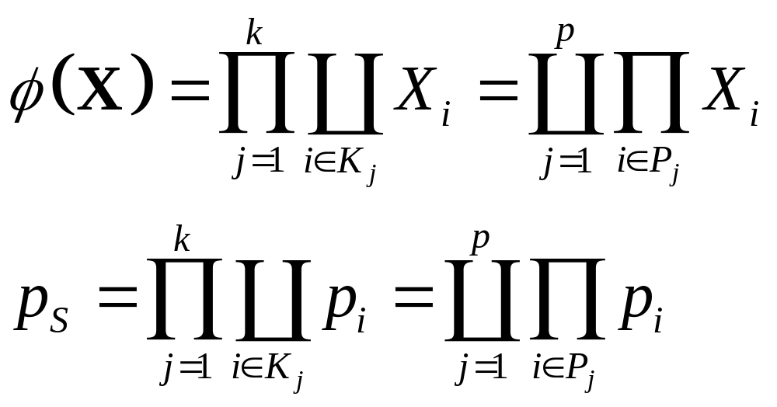
Reliability Computation Based on Minimal Cut or Path Sets

Slide 33
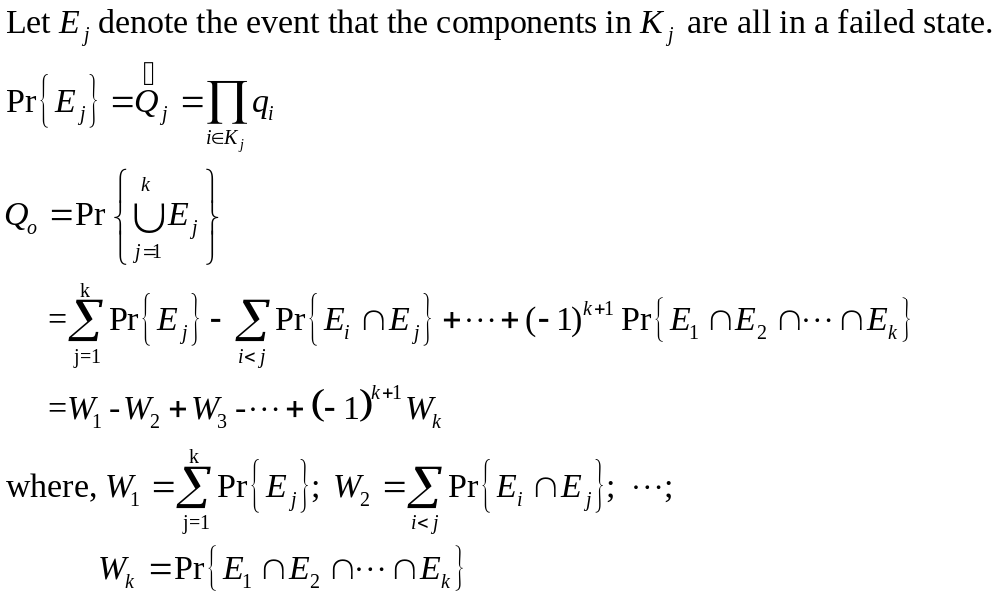
Unreliability Computation Based on Inclusion-Exclusion Principle

Slide 34
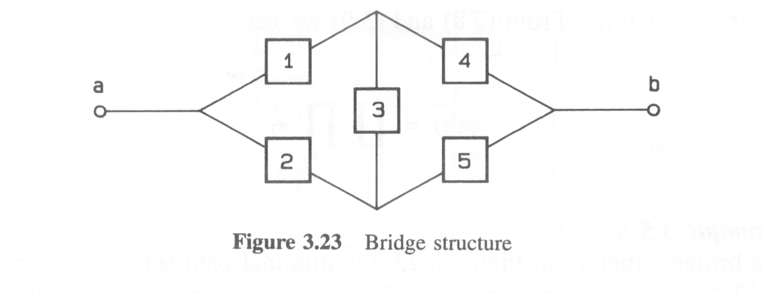
Example

Slide 35
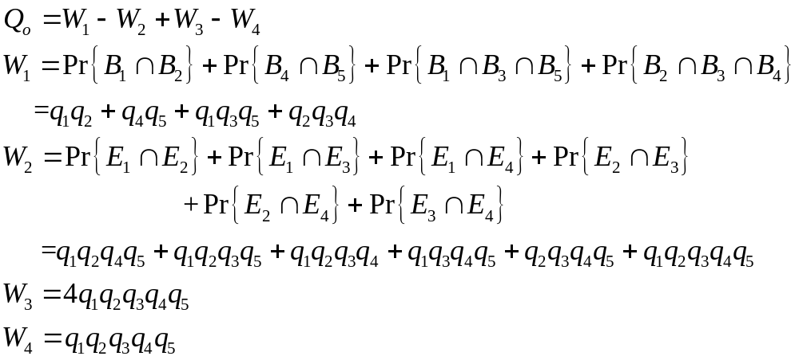
Example

Slide 36
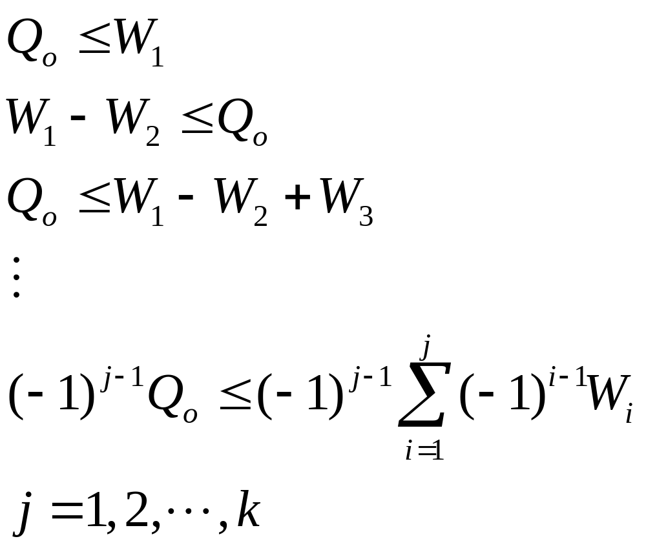
Upper and Lower Bounds of System Unreliability

Slide 37
Redundant Structure and Standby Units

Slide 38
Active Redundancy
The redundancy obtained by replacing the important unit with two or more units operating in parallel.

Slide 39
Passive Redundancy
The reserve units can also be kept in standby in such a way that the first of them is activated when the original unit fails, the second is activated when the first reserve unit fails, and so on. If the reserve units carry no load in the waiting period before activation, the redundancy is called passive. In the waiting period, such a unit is said to be in cold standby.

Slide 40
Partly-Loaded Redundancy
The standby units carry a weak load.

Slide 41
Cold Standby, Passive Redundancy, Perfect Switching, No Repairs

Slide 42
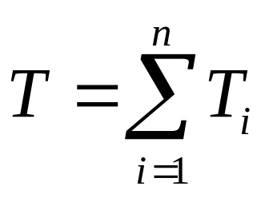

Life Time of Standby System
The mean time to system failure

Slide 43
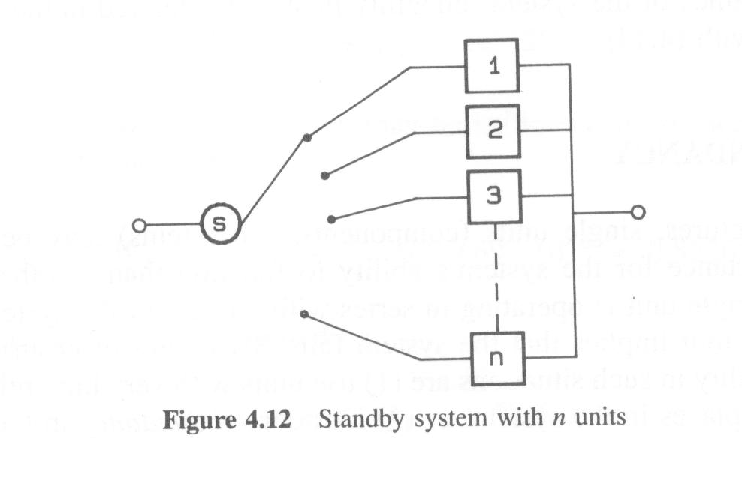

Slide 44
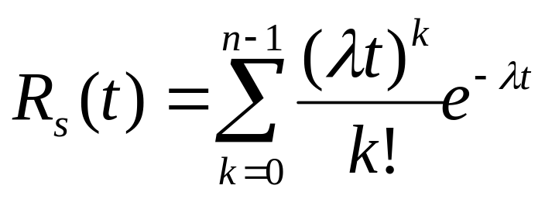
Exact Distribution of Lifetime
If the lifetimes of the n components are independent and exponentially distributed with the same failure rate λ. It can be shown that T is gamma distributed with parameters n and λ. The survivor (reliability) function is

Slide 45
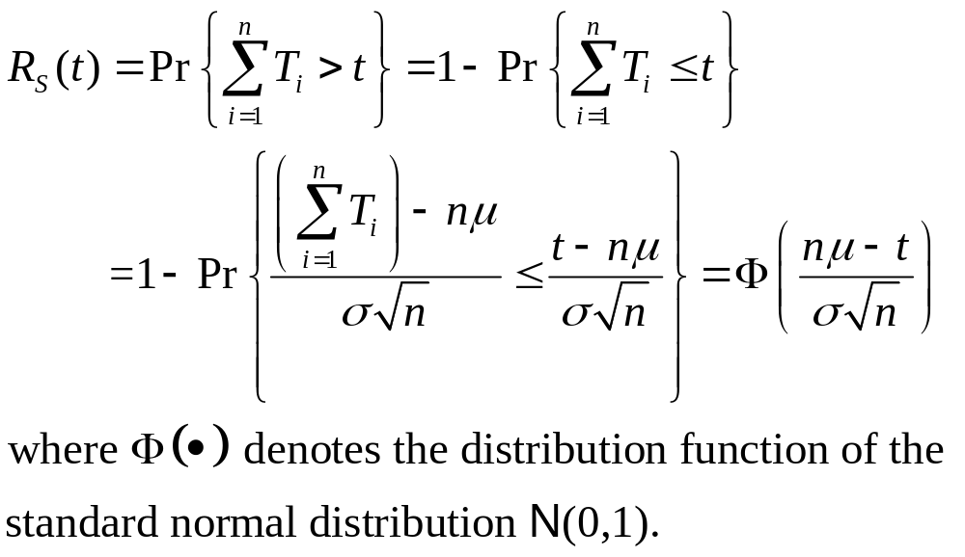
Approximate Distribution of Lifetime
Assume that the lifetimes are independent and identically distributed with mean time to failure μ and standard deviation σ. According to Lindeberg-Levy’s central limit theorem, T will be asymptotically normally distributed with mean nμ and variance nσ^2.

Slide 46
Cold Standby, Imperfect Switching, No Repairs

Slide 47
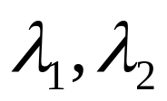
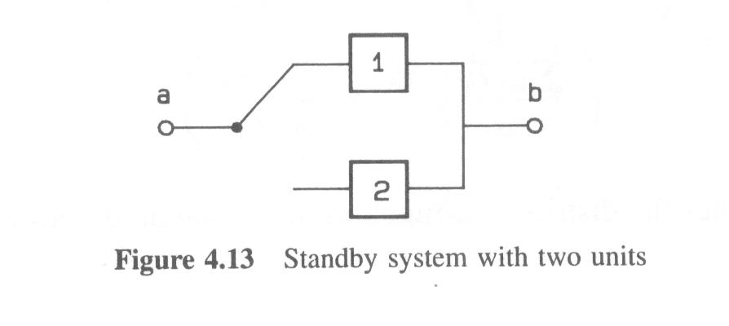
2-Unit System
A standby system with an active unit (unit 1) and a unit in cold standby. The active unit is under surveillance by a switch, which activates the standby unit when the active unit fails.
Let be the failure rate of unit 1 and unit 2 respectively; Let (1-p) be the probability that the switching is successful.

Slide 48
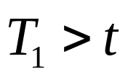
Two Disjoint Ways of Survival
Unit 1 does not fail in (0, t], i.e.
Unit 1 fails in the time interval (τ, τ+dτ], where 0<τ<t. The switch is able to activate unit 2. Unit 2 is activated at time τ and does not fail in the time interval (τ,t].

Slide 49
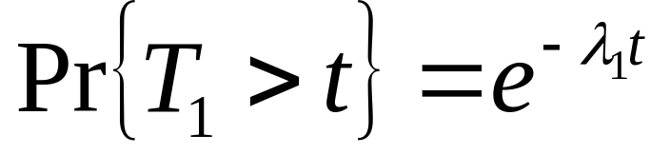
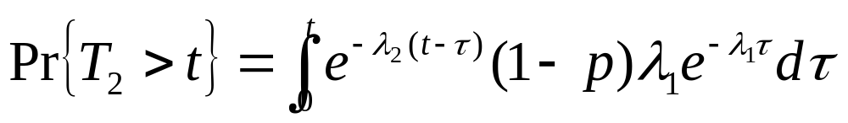
Probabilities of Two Disjoint Events
Event 1:
Event 2:
Unit 1 fails
Unit 2 working
afterwards
Switching
successful

Slide 50
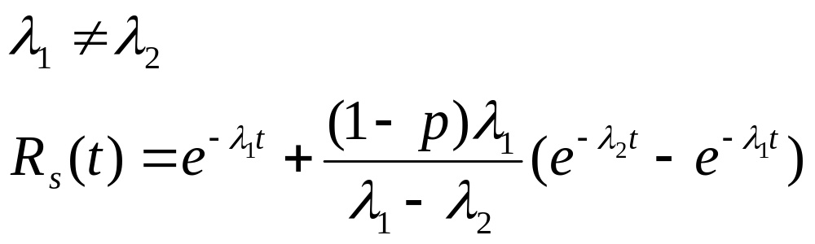
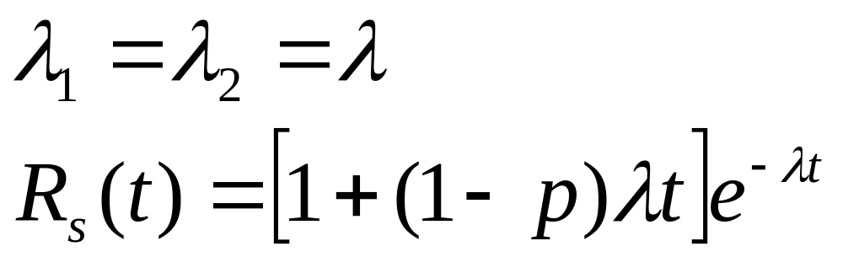
System Reliability

Slide 51
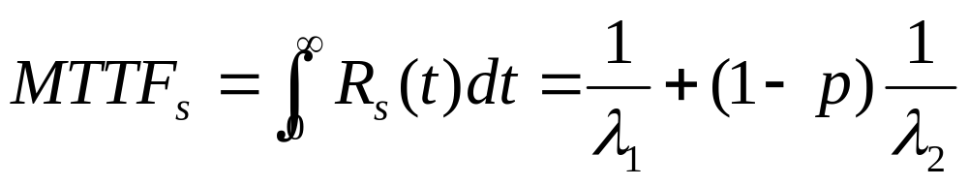
Mean Time to Failure

Slide 52
Partly-Loaded Redundancy, Imperfect Switching, No Repairs

Slide 53

Two-Unit System
Same as before except unit 2 carries a certain load before it is activated. Let denote the failure rate of unit 2 while in partly-loaded standby.

Slide 54
Two Disjoint Ways of Survival
Unit 1 does not fail in (0, t], i.e.
Unit 1 fails in the time interval (τ, τ+dτ], where 0<τ<t. The switch is able to activate unit 2. Unit 2 does not fail in (0, τ], is activated at time τ and does not fail in the time interval (τ,t].

Slide 55
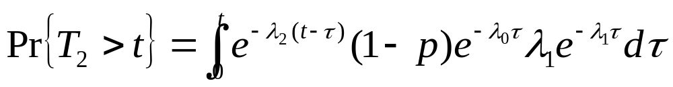
Probabilities of Two Disjoint Events
Event 1:
Event 2:
Unit 1 fails
at τ
Unit 2 still
working
after τ
Switching
successful
Unit 2 working
in (0, τ]

Slide 56


System Reliability

Slide 57

Mean Time to Failure

